Slide 1
Choose One City
Start Your Career
A Report for Choosing Your First Job

Slide 2
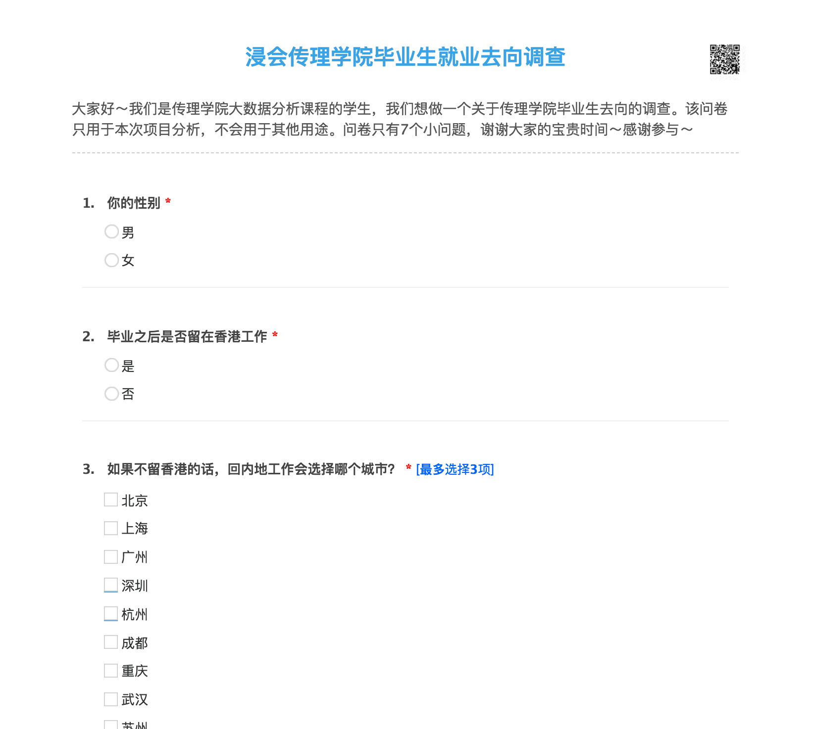
Questionnaire
Feedback
151 effective feedbacks
More than 60 percent

Slide 3
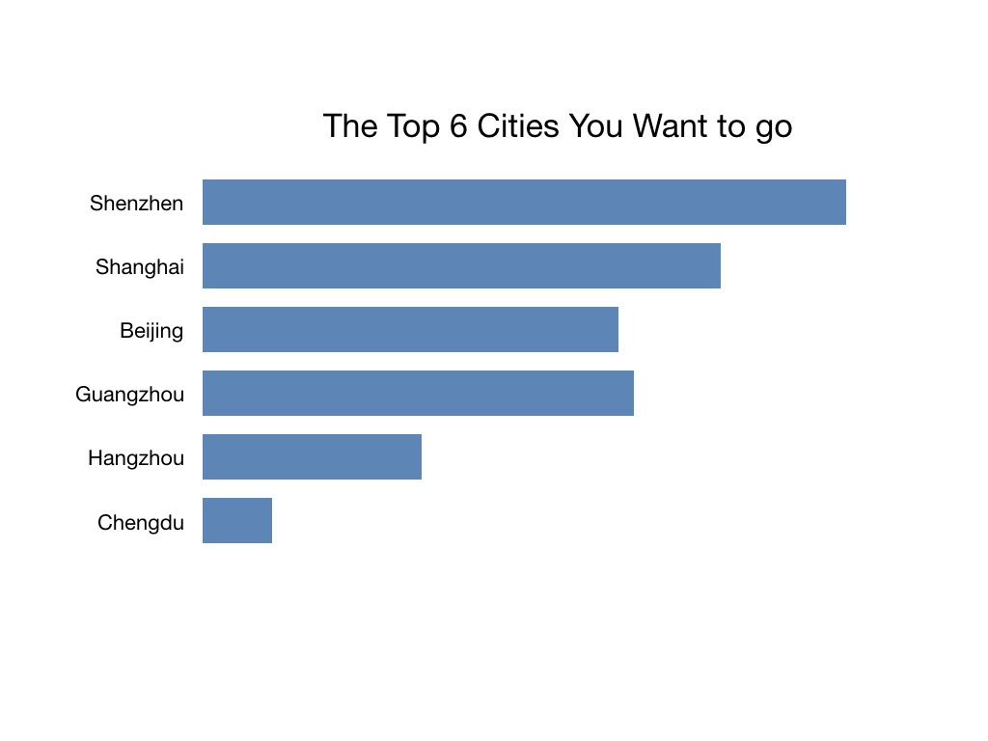
Graduation Choices Analysis
- 2018 HKBU School of Communication
Shenzhen - 54.3 percent
Shanghai - 43.71 percent
Guangzhou - 36.42 percent
Preferred Cities

Slide 4
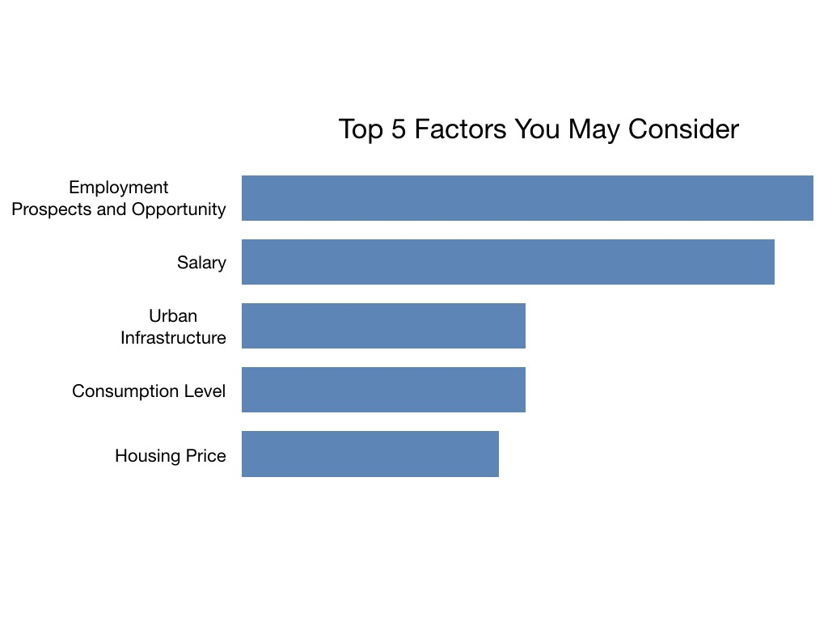
Graduation Choices Analysis
- 2018 HKBU School of Communication
There are two factors that students surveyed consider most: the employment opportunities and career prospects in a city; the industry’s average salary
Choosing Standards of Cities

Slide 5
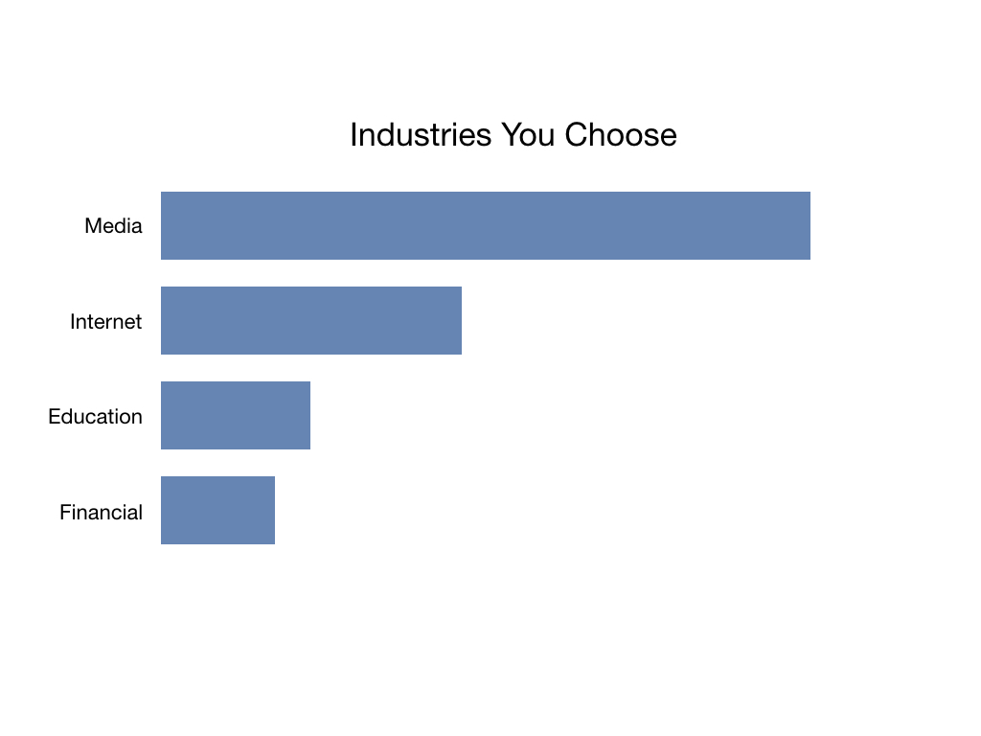
Graduation Choices Analysis
- 2018 HKBU School of Communication
More than 80 percent choose media as the industry they would like to step in after graduation
Industry Preference

Slide 6
Graduation Choices Analysis
- 2018 HKBU School of Communication
In this project, what we are going to analyze:
Job opportunities
Average salary level of media industry
Housing price-to-income ratio
Talent attraction Policies

Slide 7
Detailed Analysis

Slide 8
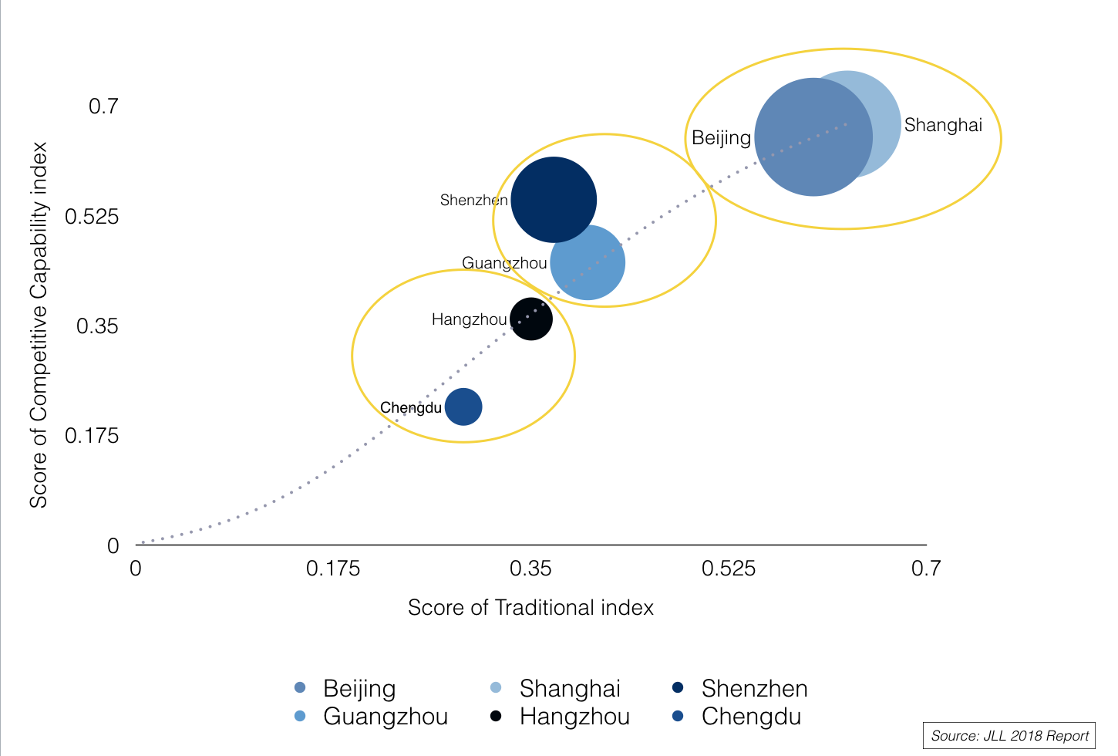
The Curve of Chinese 6 Cities’ Development
Global Competitors
Innovators
Fast Growing Cities

Slide 9
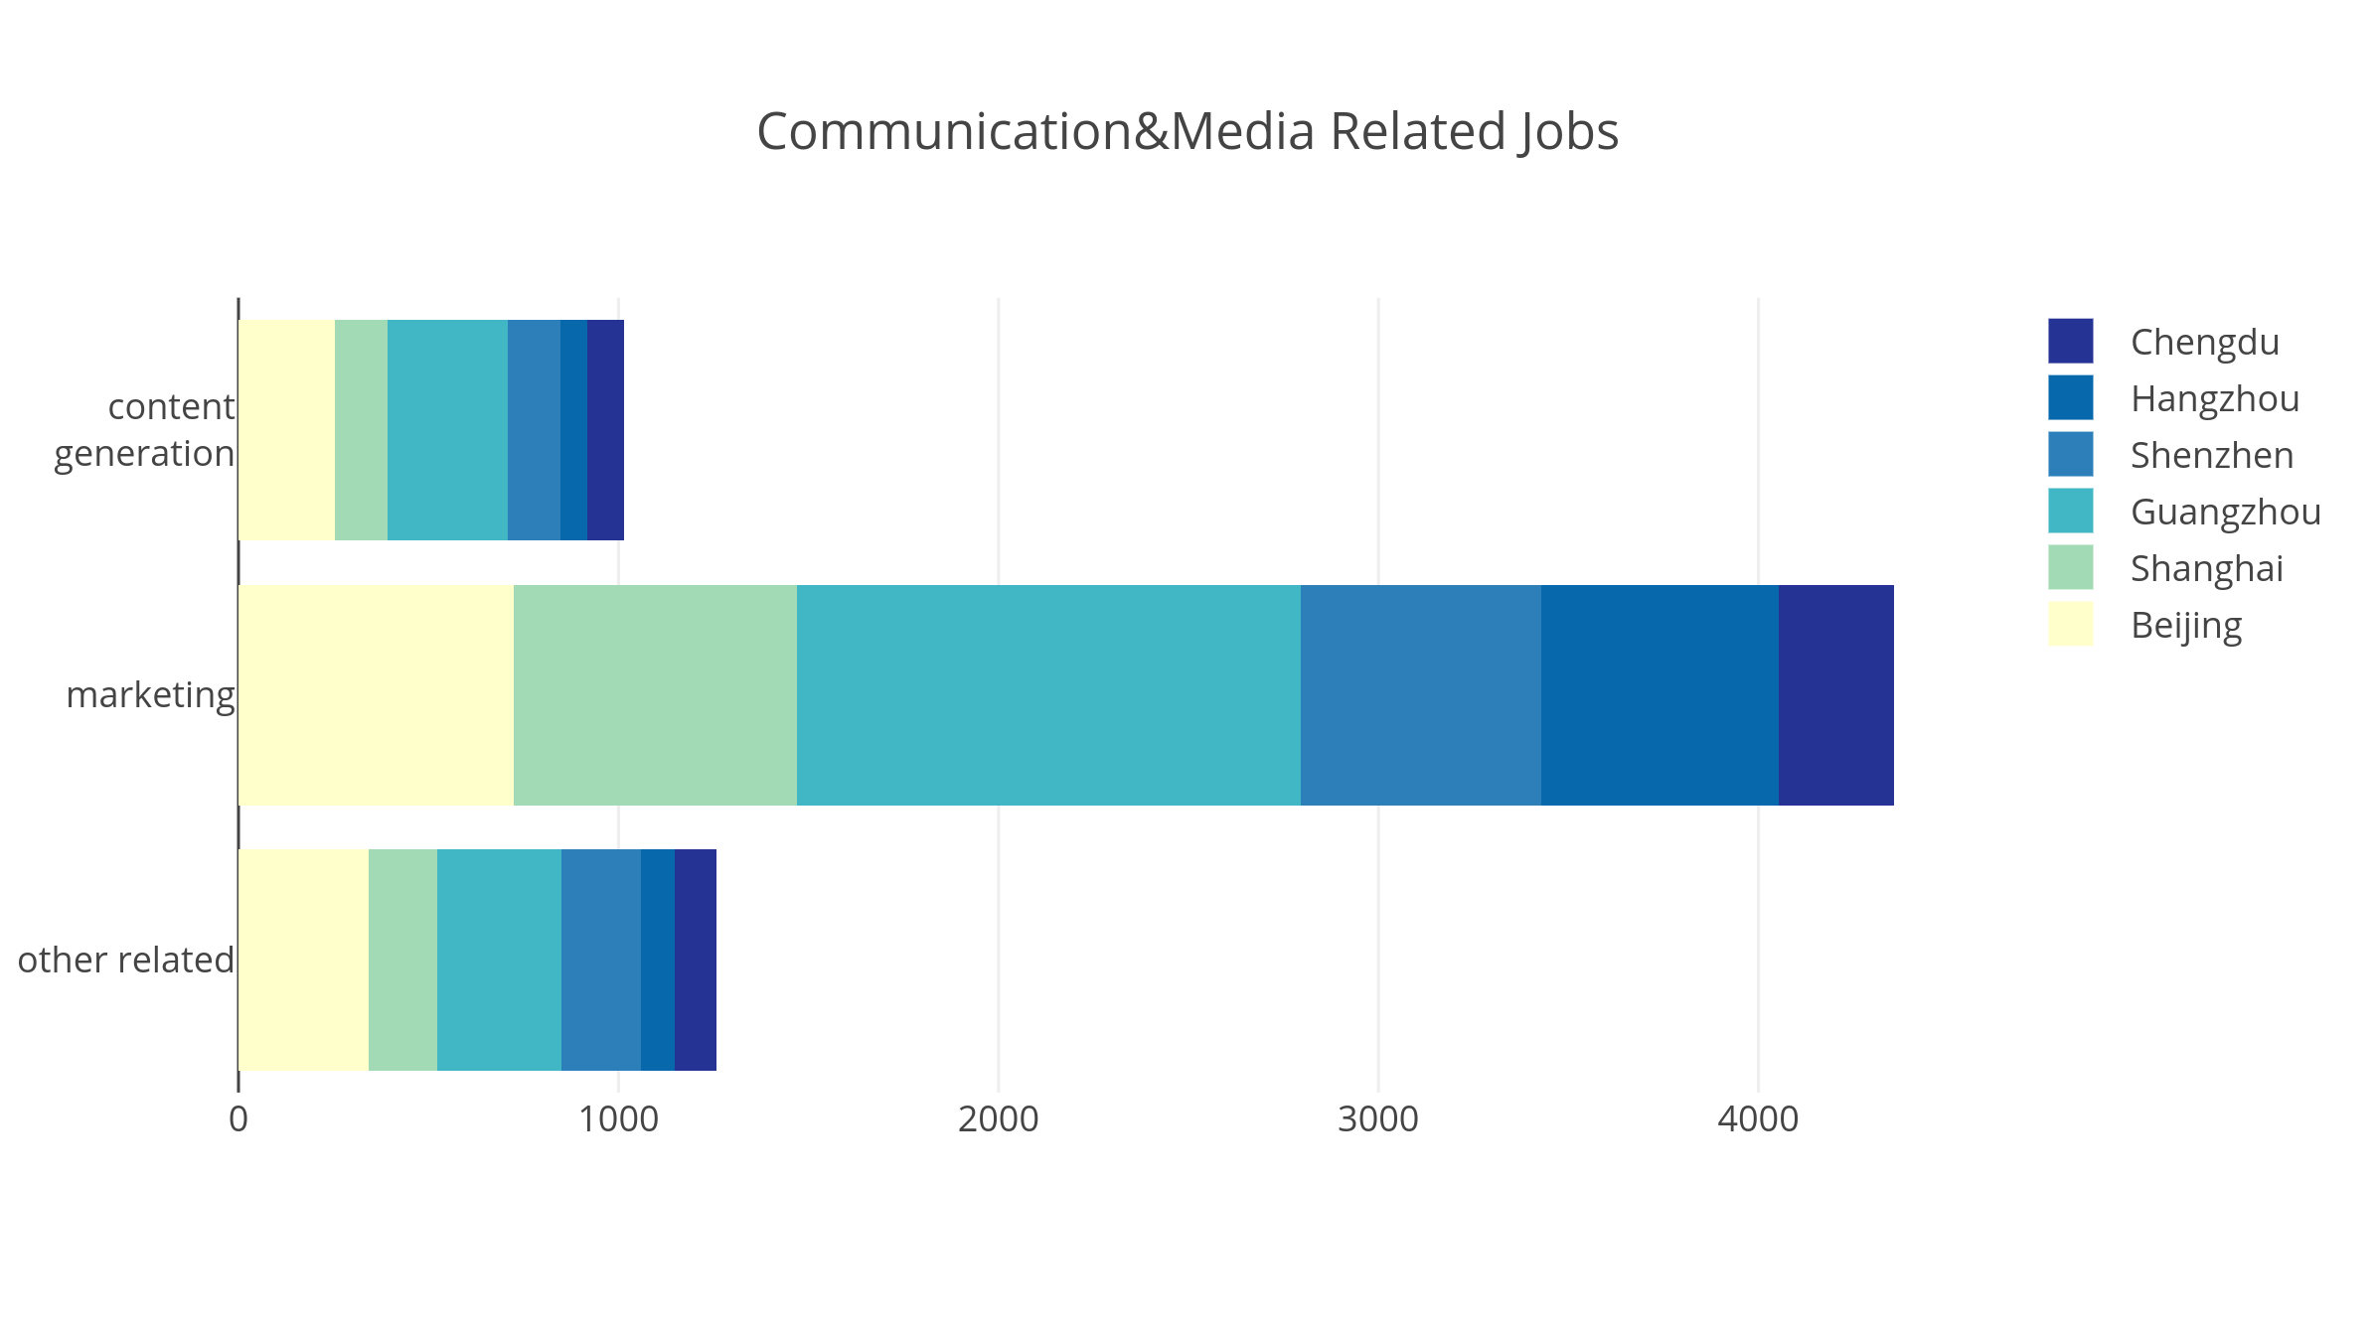
INDUSTRY
- How many Media-Related Companies in Preferred Cities
Hangzhou:
Least Amount of Companies
Guangzhou:
Largest Amount of Companies
Data Resource: 51Job Website

Slide 10
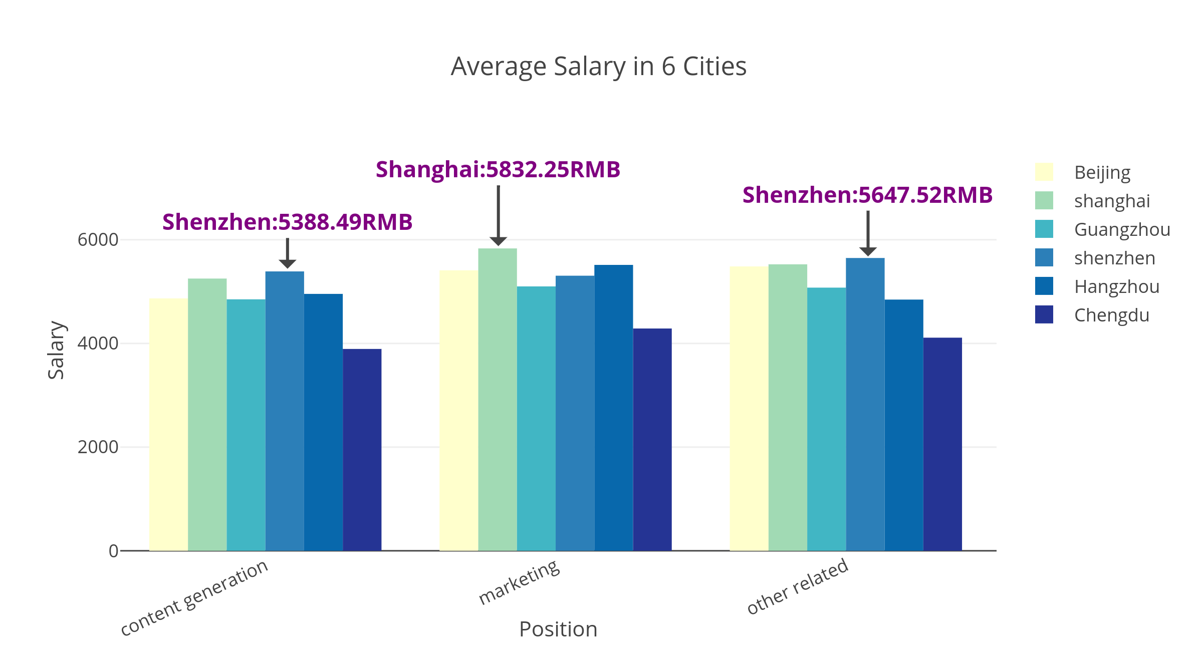
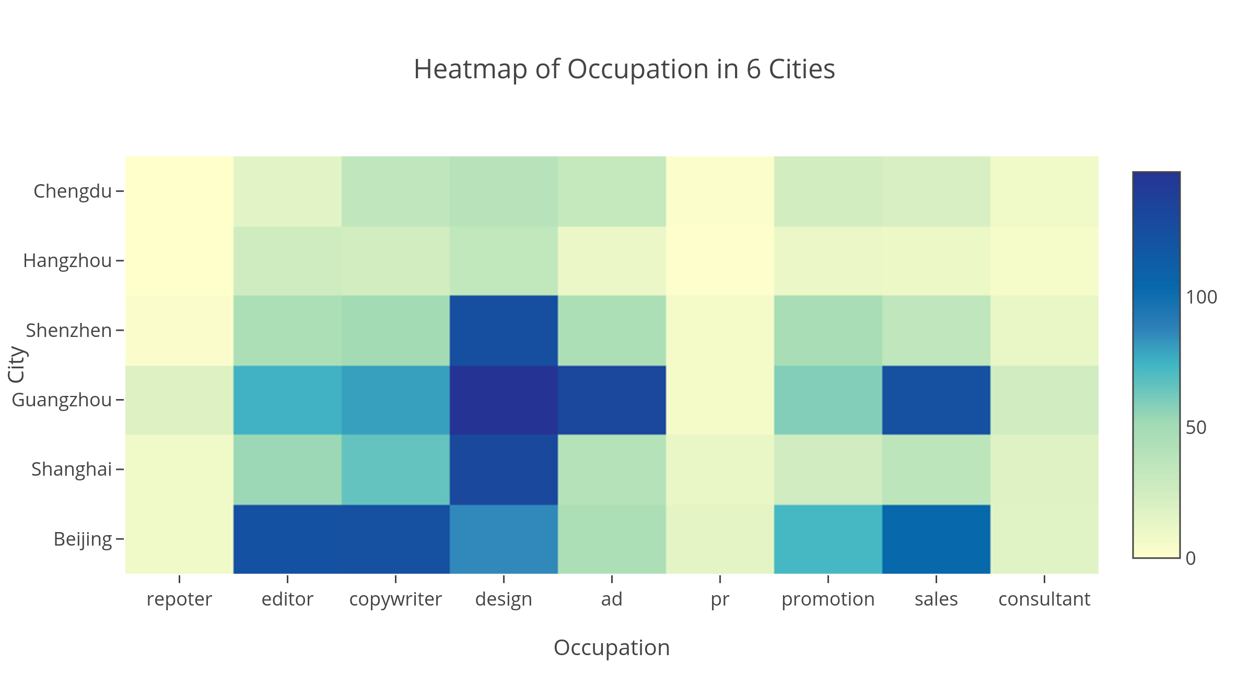
INUDSTRY
- Salary Level of Media Industry in Preferred Cities
Data Resource: 51Job Website

Slide 11
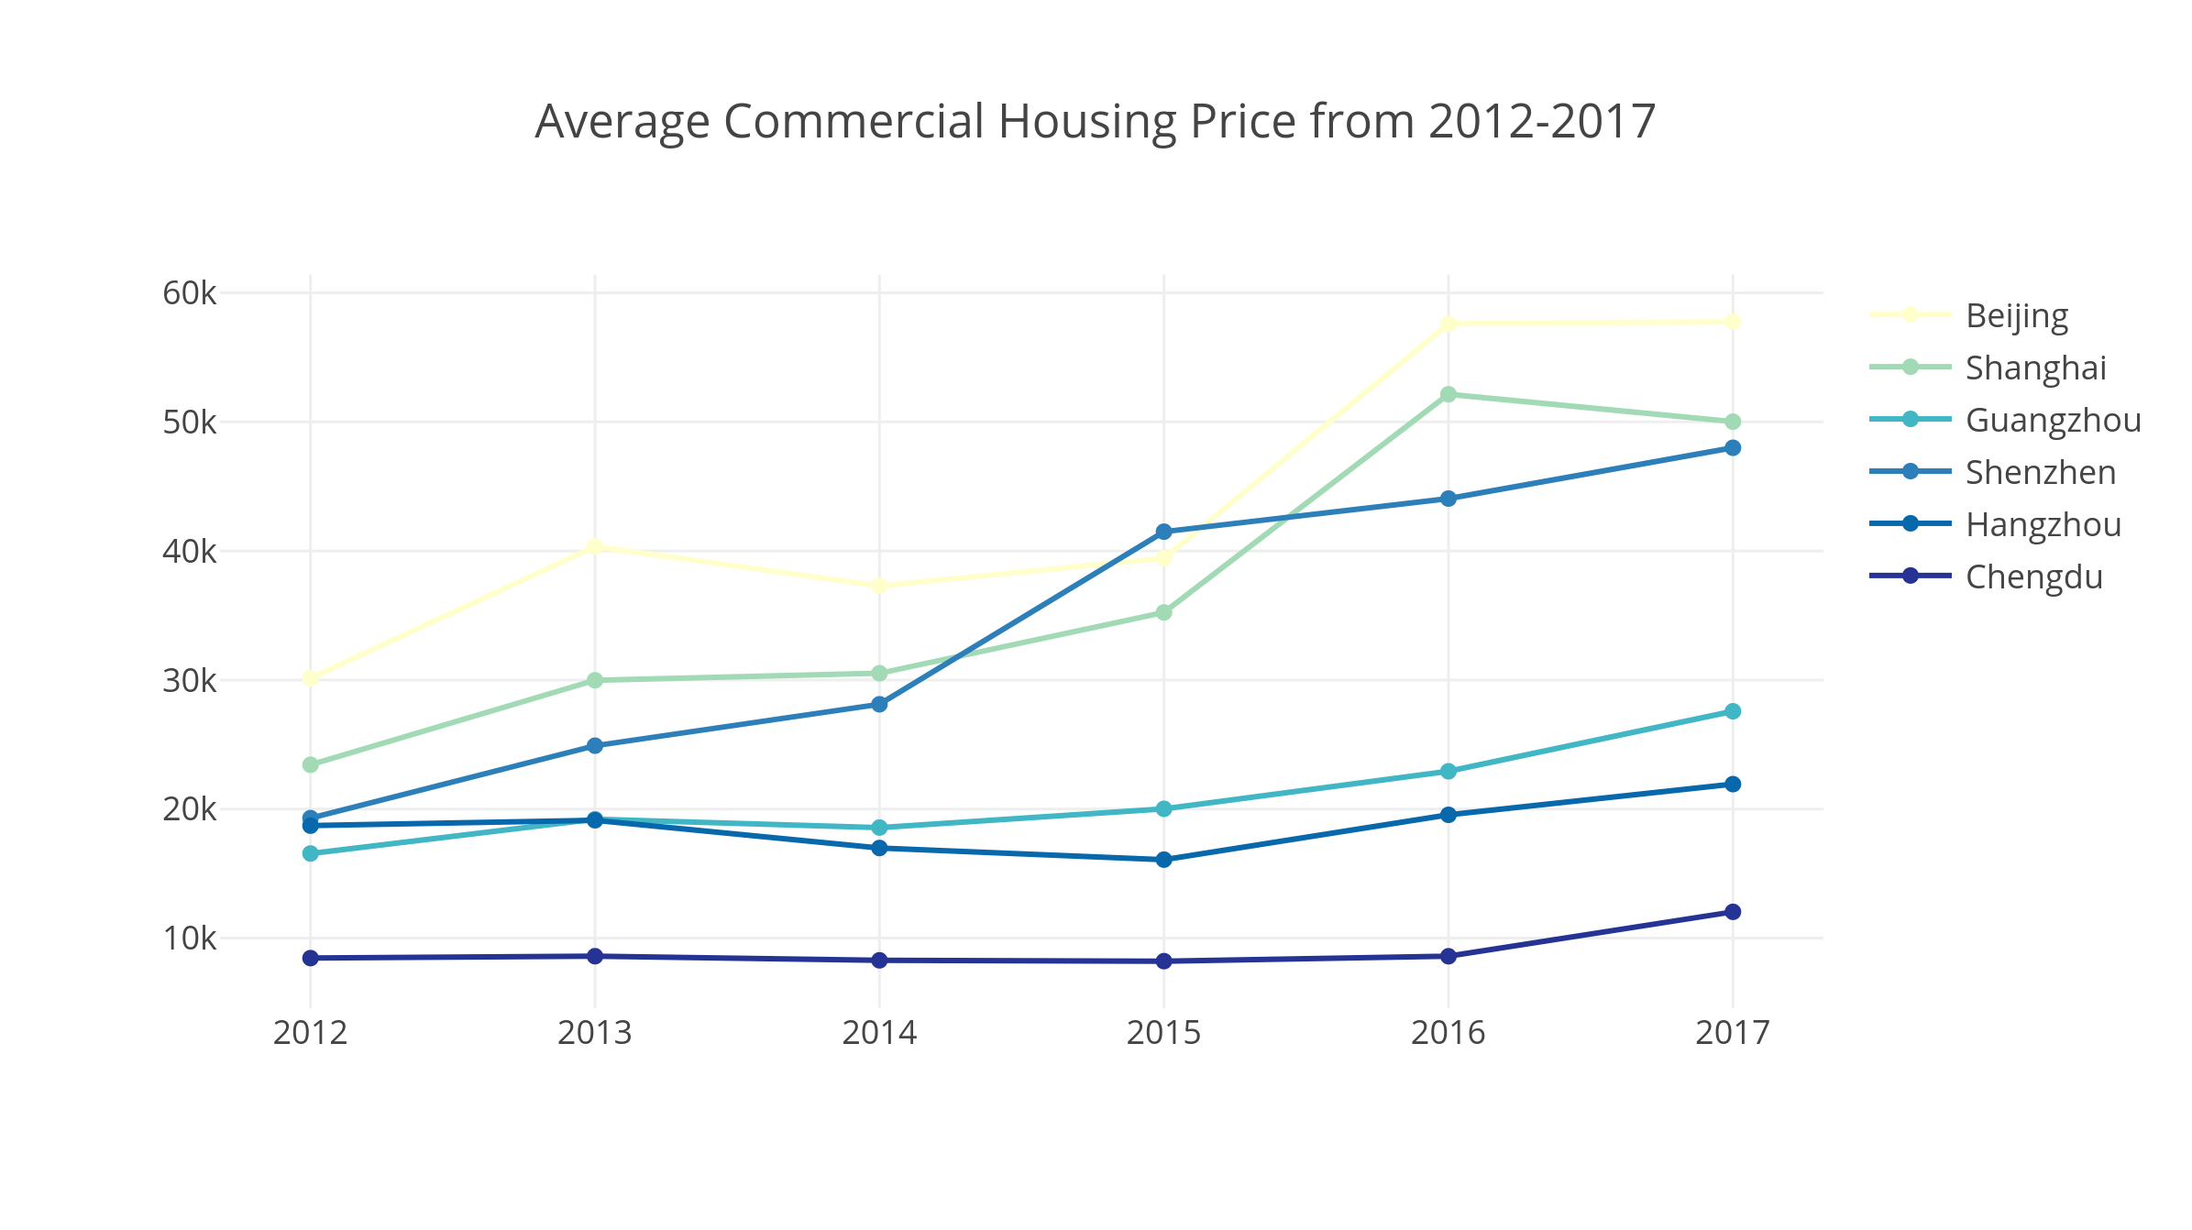
HOUSING PROBLEM
- Average Commercial Housing Prices of Six Preferred Cities
Data Resource: National Bureau of Statistics of the people’s Republic of China

Slide 12
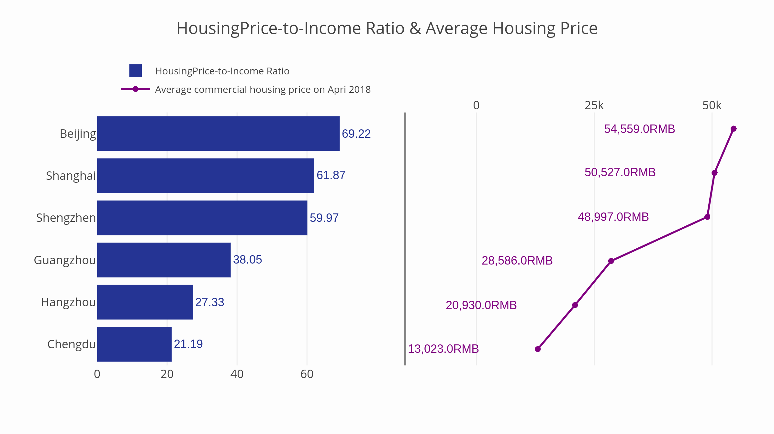
HOUSING PROBLEM
- Compare Your Salary with the Housing-Price
$$Housing Price−to−Income Ratio=\frac{80 square meter∗Average Housing Price}{Average Monthly Wage∗12}$$
Data Resource: National Bureau of Statistics of the people’s Republic of China

Slide 13
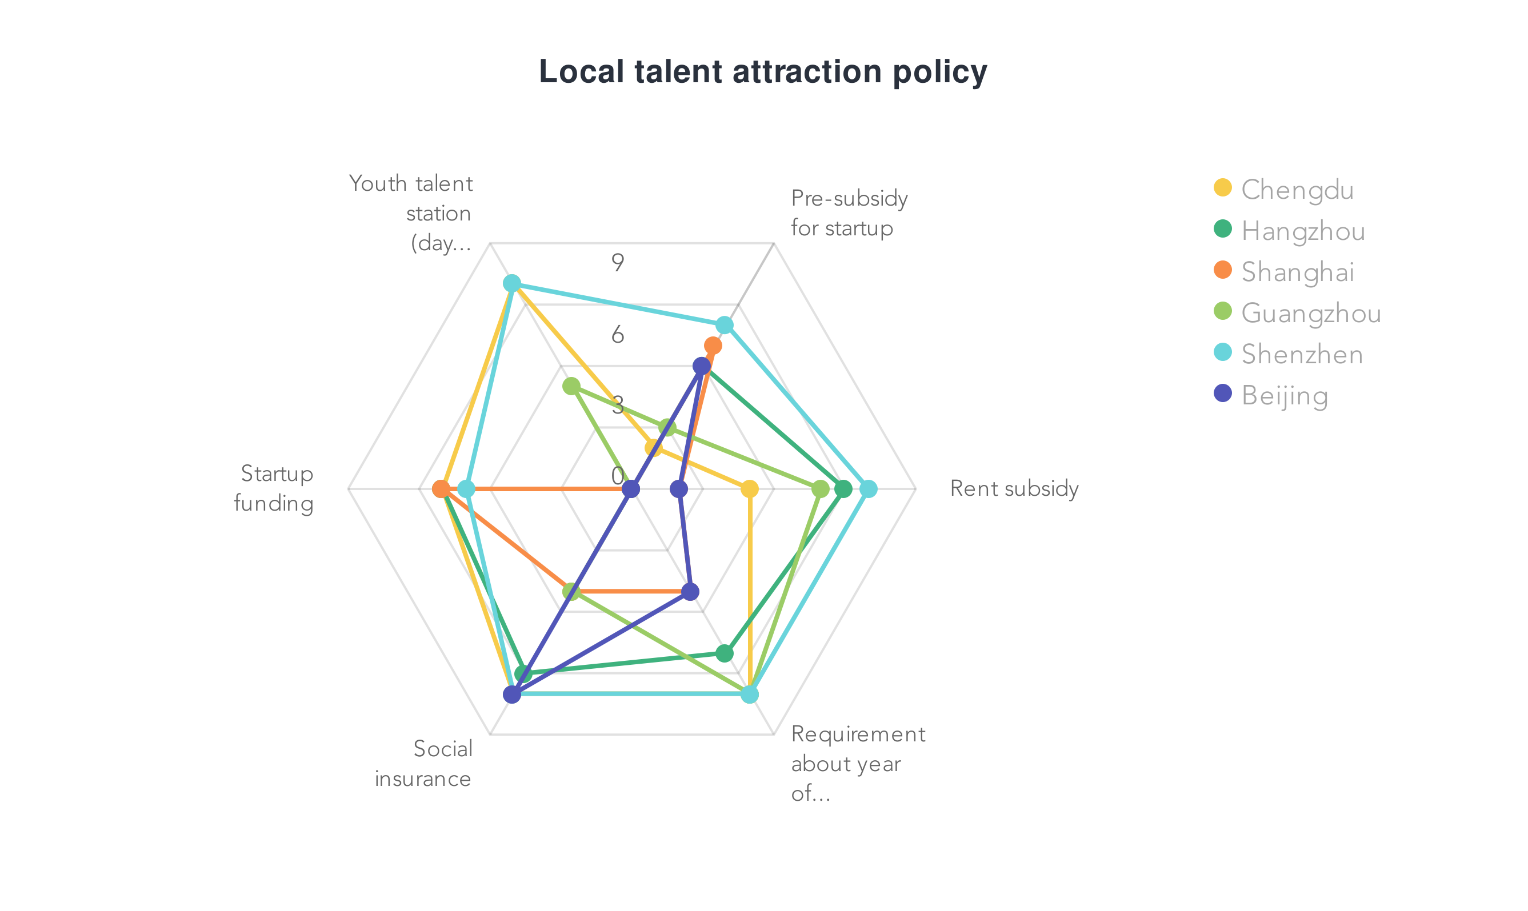
TALENTS ATTRACTION POLICIES
- Analysis of Six Students’ Preferred Cities

Slide 14
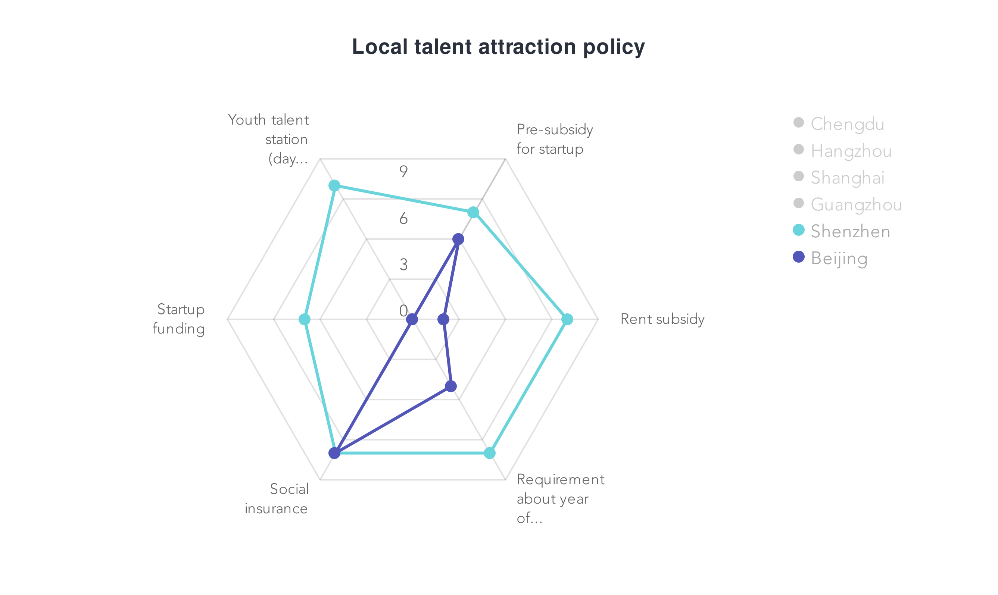
SHEN ZHEN vs BEIJING

Slide 15
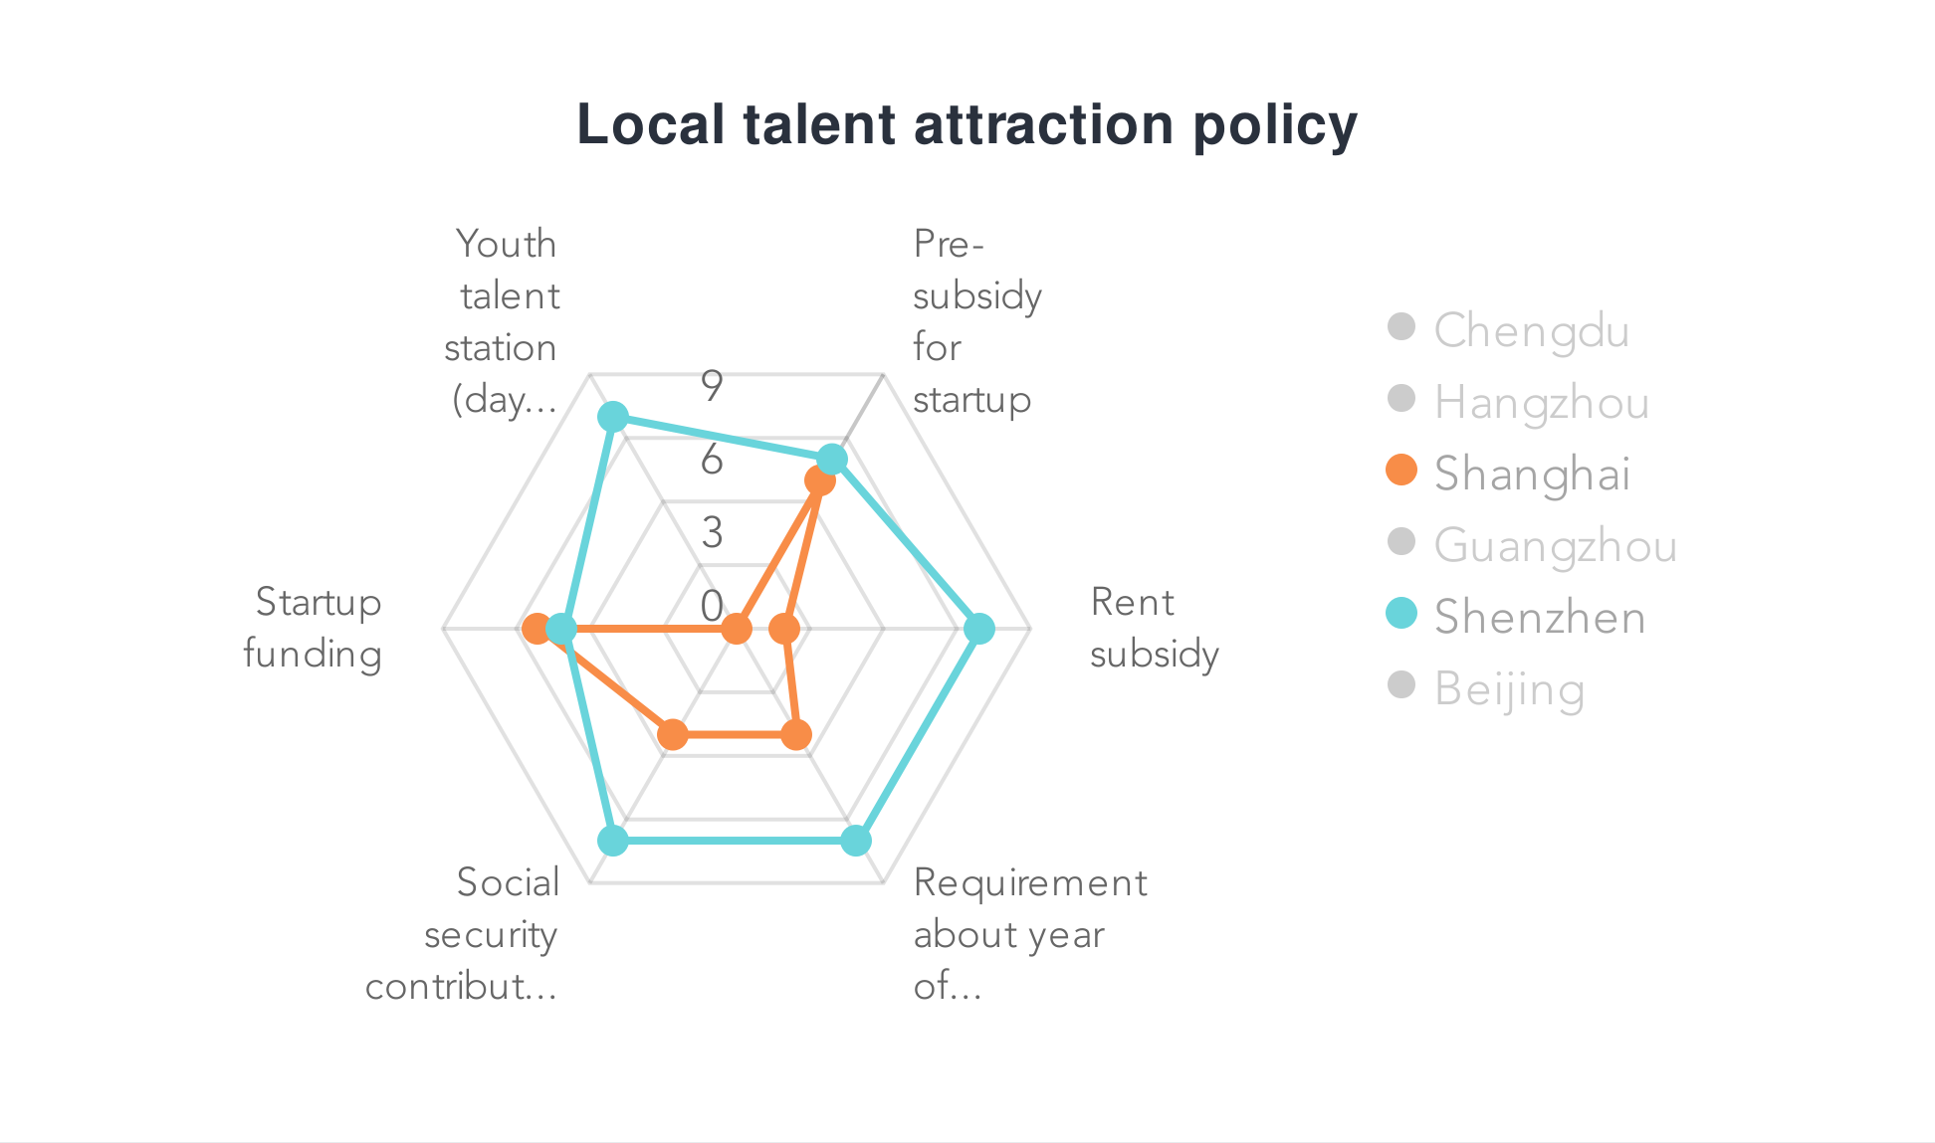
SHEN ZHEN vs SHANGHAI

Slide 16
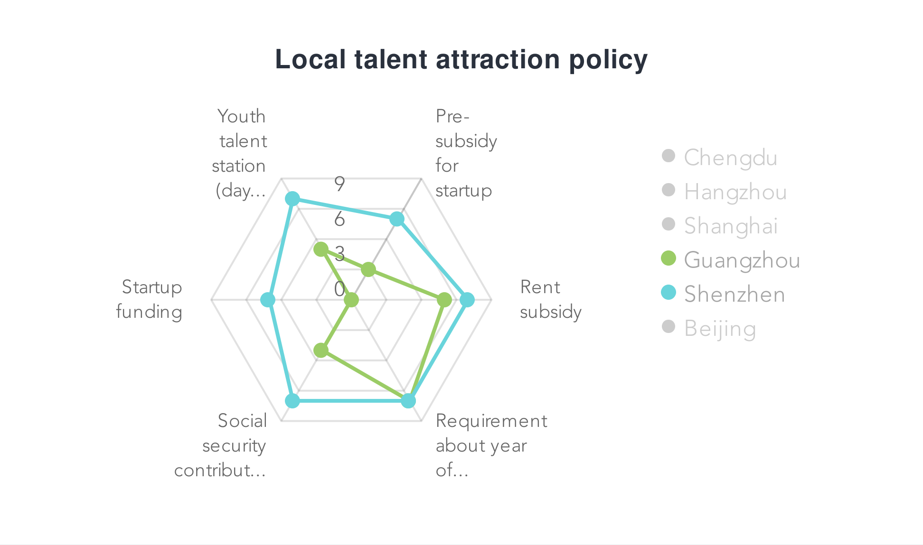
SHEN ZHEN vs GUANGZHOU

Slide 17
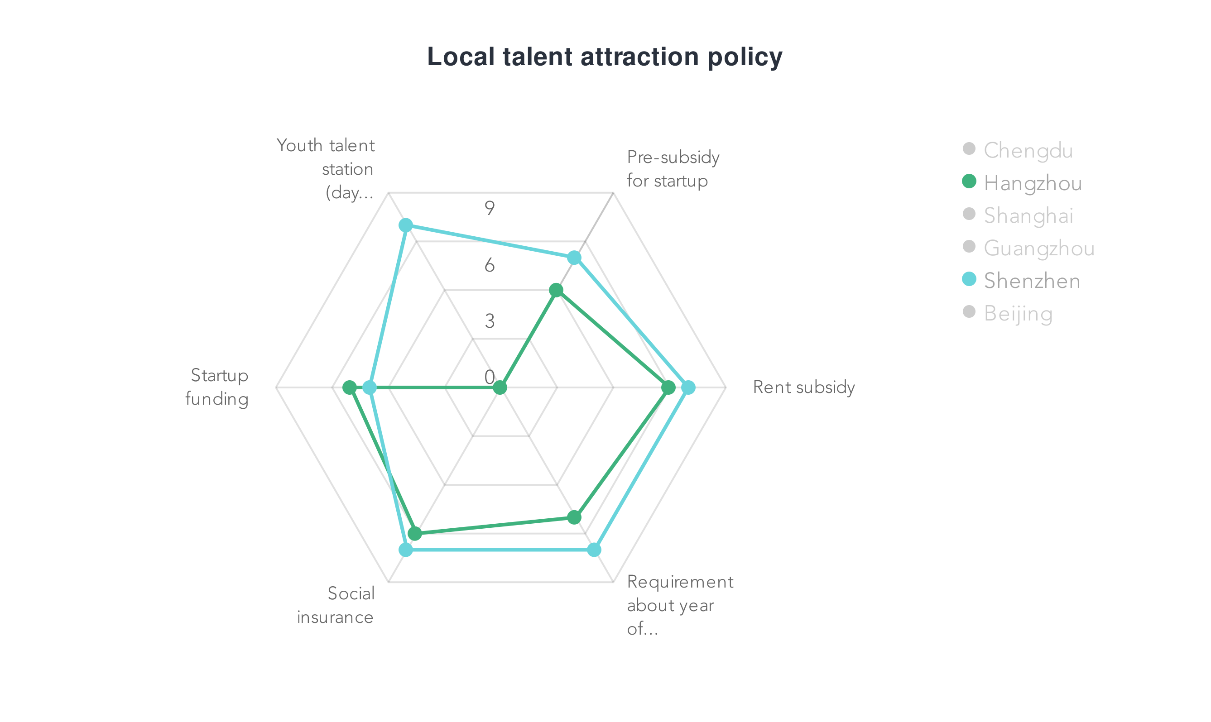
SHEN ZHEN vs HANGZHOU

Slide 18
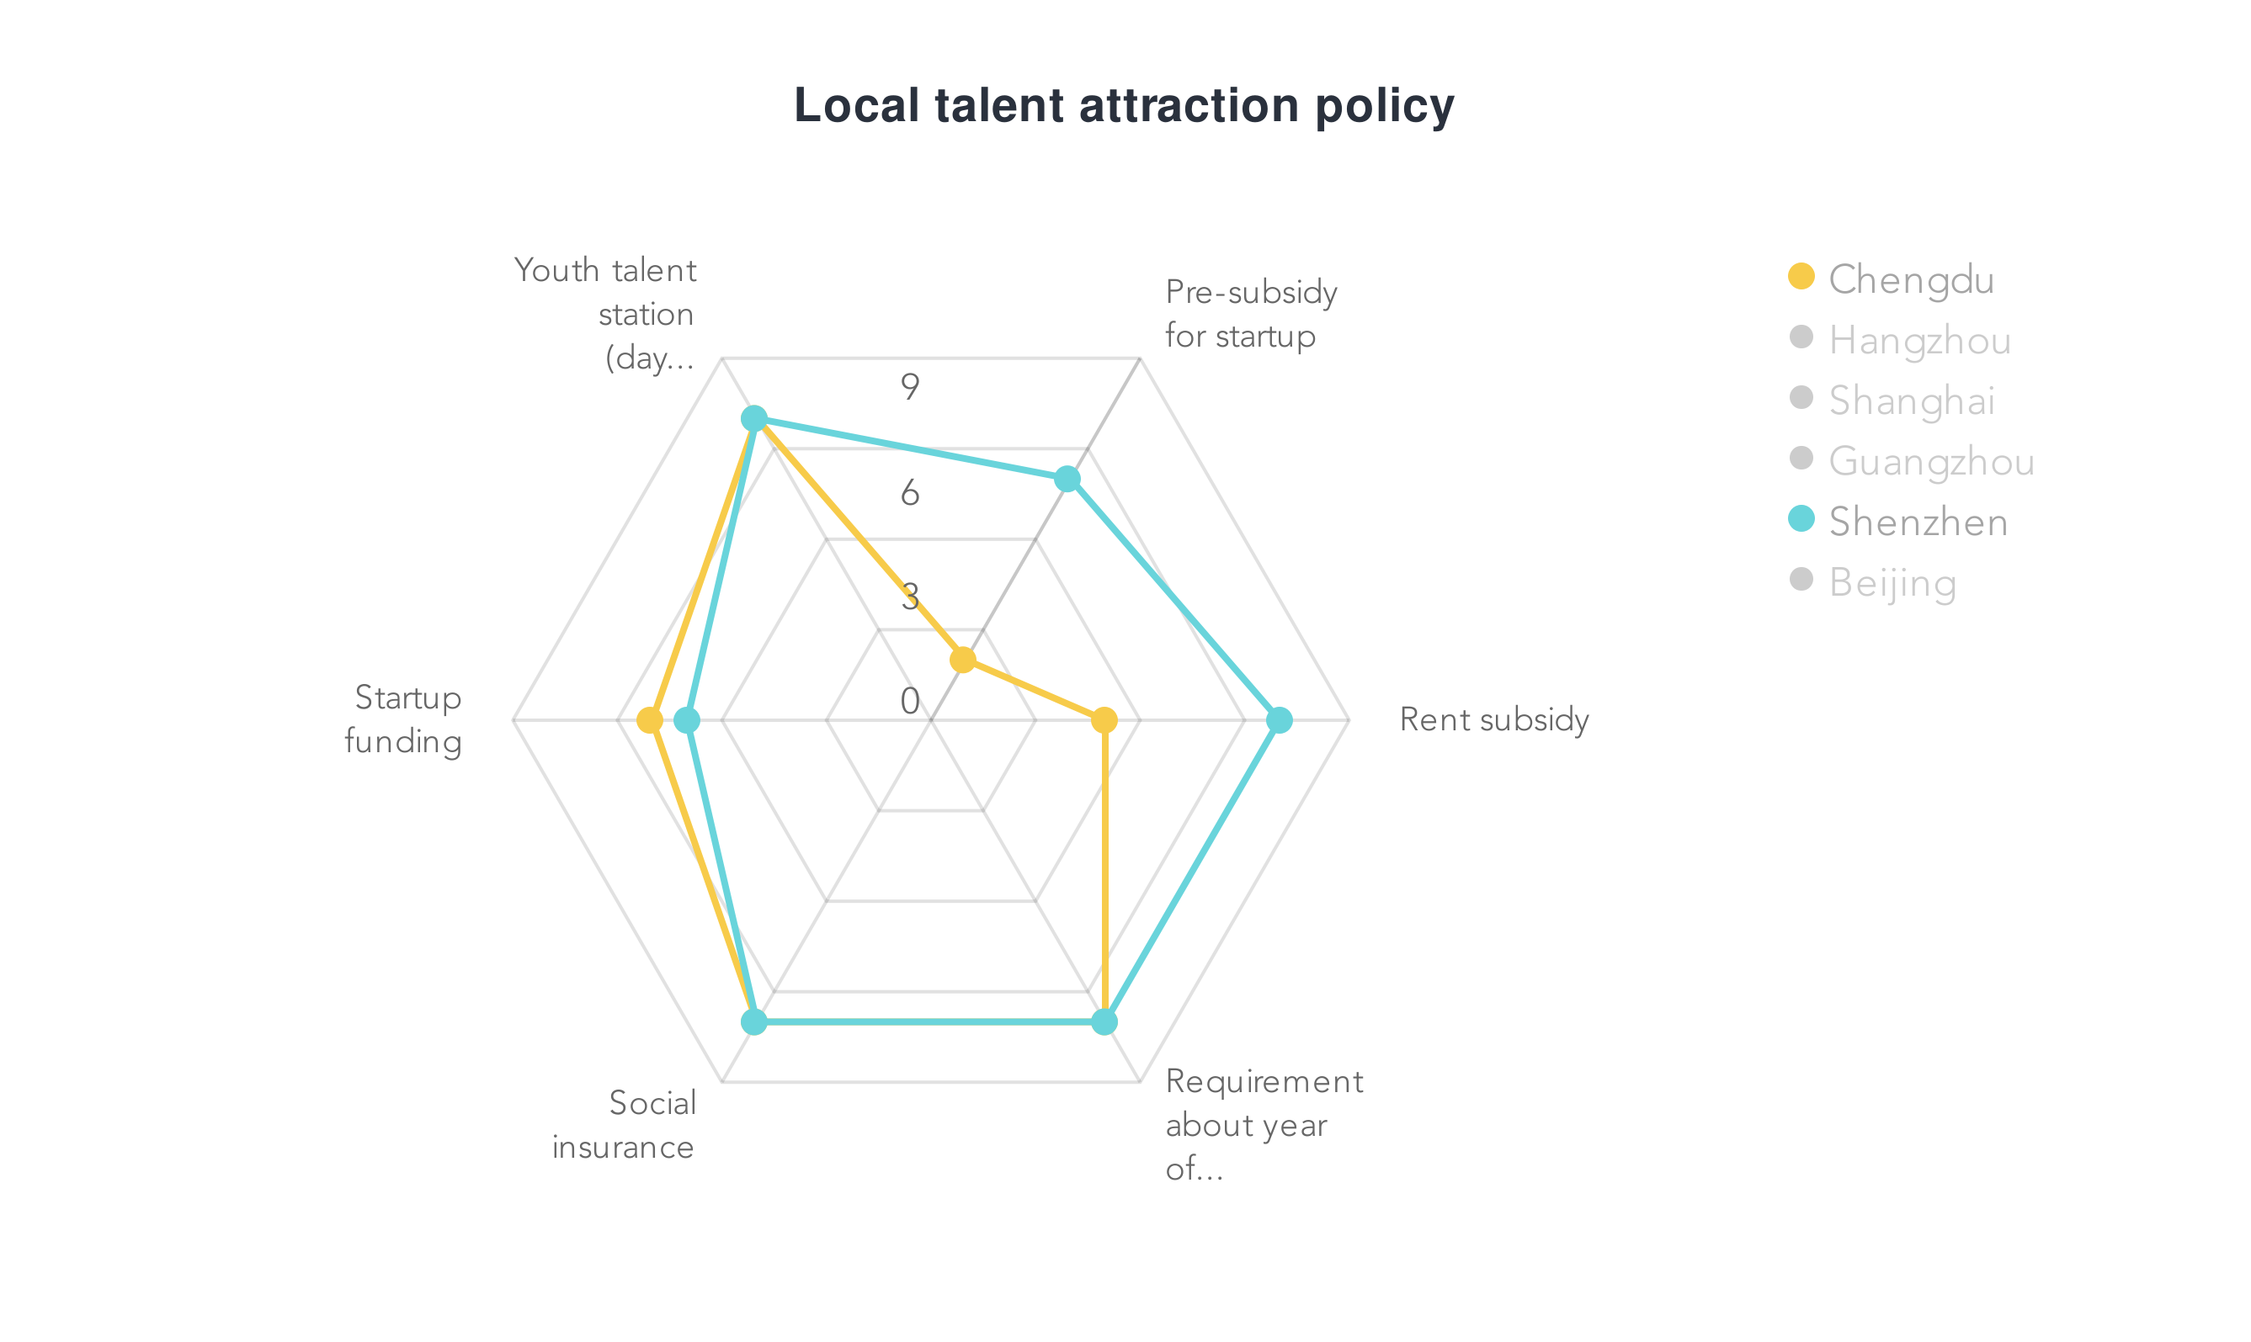
SHEN ZHEN vs CEHNGDU

Slide 19

The Curve of Chinese 6 Cities’ Development
Global Competitors
Most influential cities/good industry present and outlook
Gathering area of “house slave”
High threshold talent policy
Fast Growing Cities:
Less industrial competitiveness FOR NOW!
Lower life pressure
Friendly talented Policies
Global Competitors
Innovators
Innovators
remarkable development prospect& broad employment market
Good life standards
shenzhen: welcome persons of ability with its most friendly and all-side policy
Fast Growing Cities

Slide 20
Thank You For Listening

